Slide 1


Installing and getting started with R
Scott Ferson, School of Engineering, University of Liverpool, UK
Society for Risk Analysis Annual Meeting
© 2015 Applied Biomathematics

Slide 2
Installing R
Locate the latest version by Googling "R" or going to http://www.r-project.org/
Download and install the base software from a CRAN (Comprehensive R Archive Network) mirror
For instance, get version 3.2.2 for Windows from
http://cran.stat.sfu.ca/bin/windows/base/R-3.2.2-win.exe
Install R by executing this self-extracting file and invoke the program by double-clicking on the blue R icon it leaves on your desktop

Slide 3
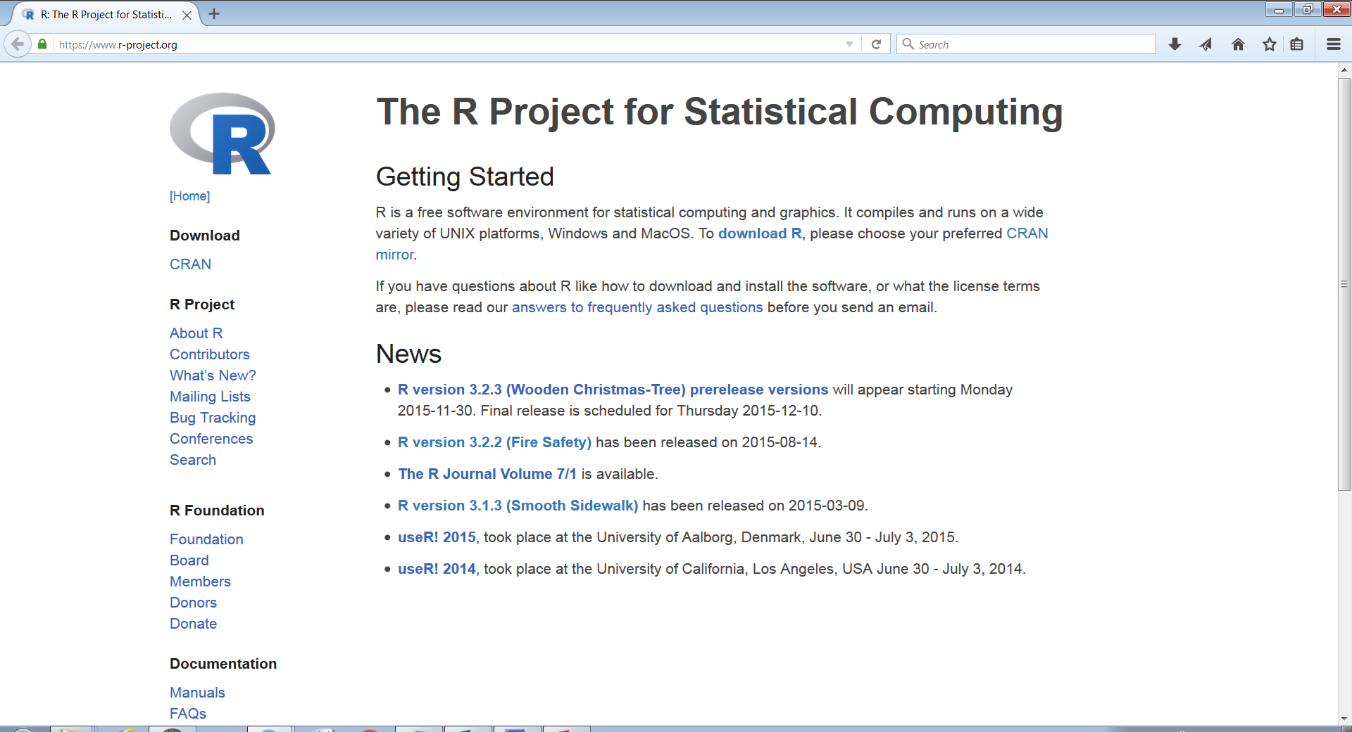
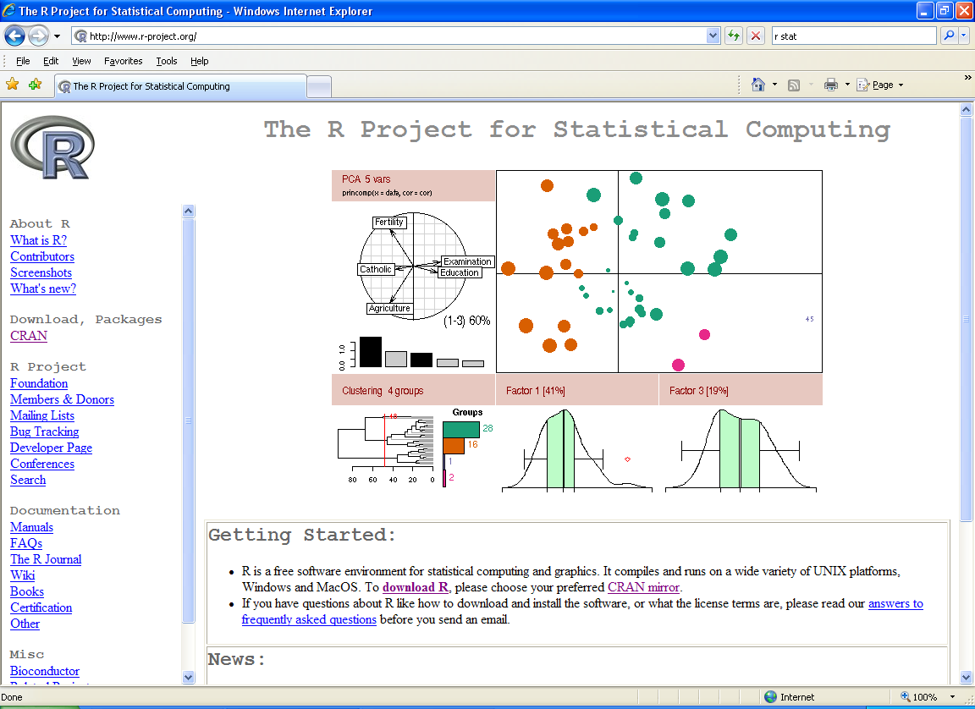

Slide 4
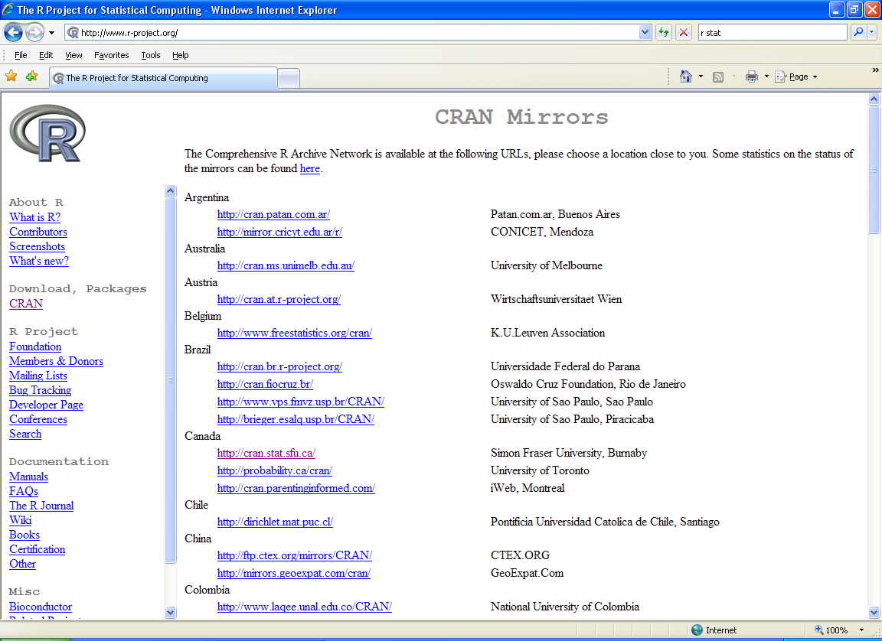
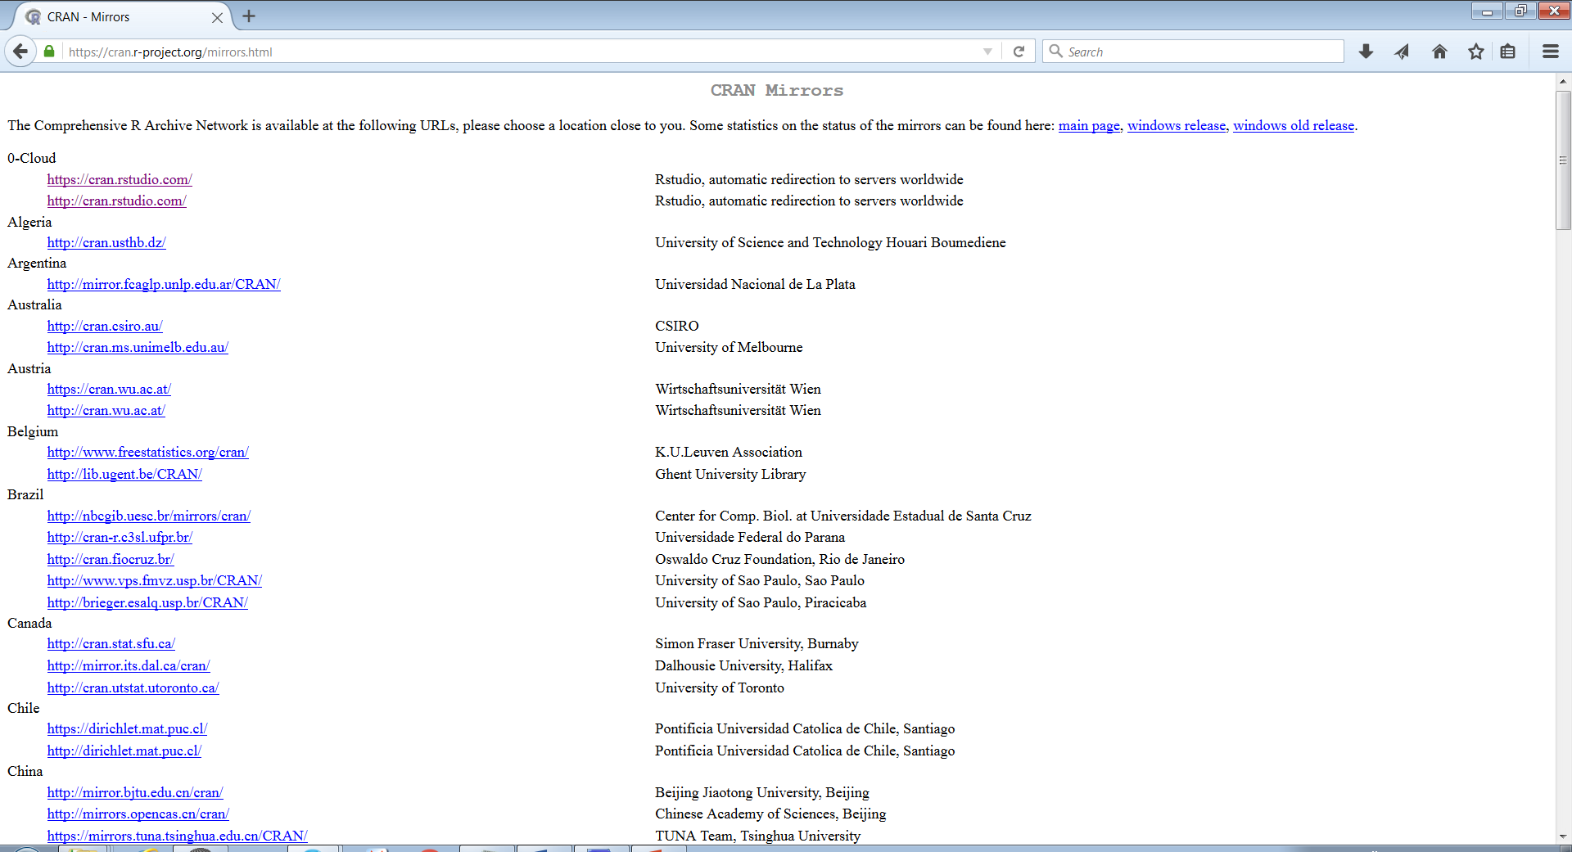

Slide 5
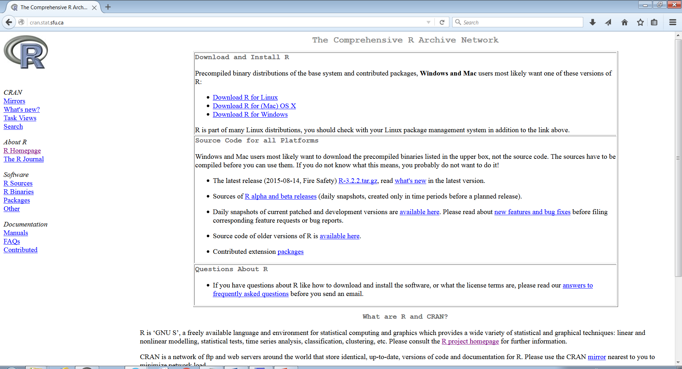
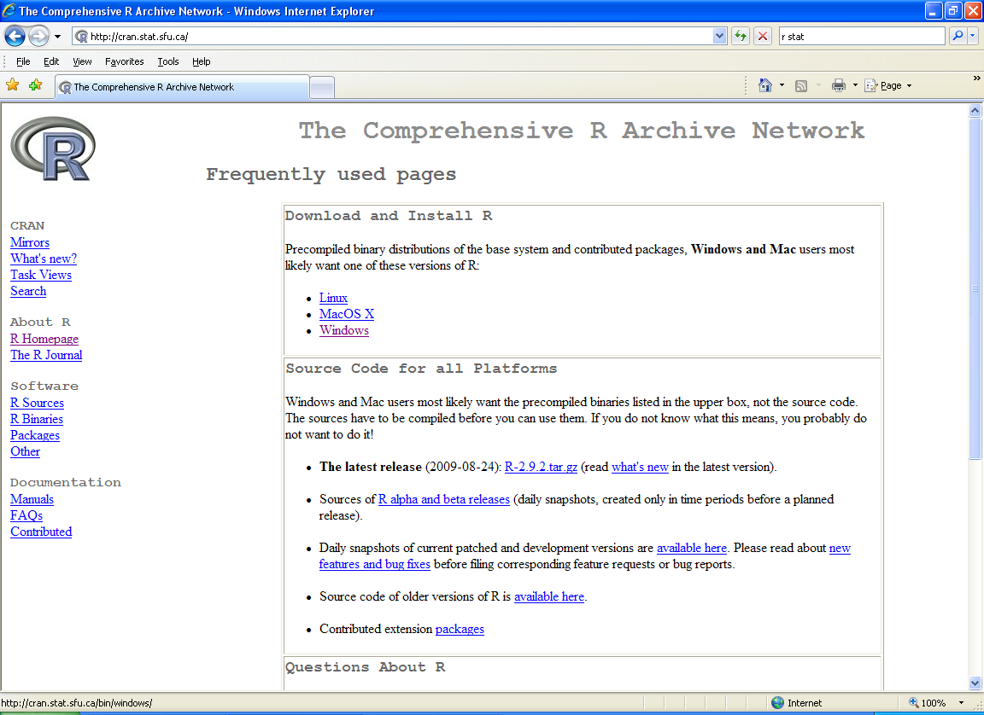

Slide 6
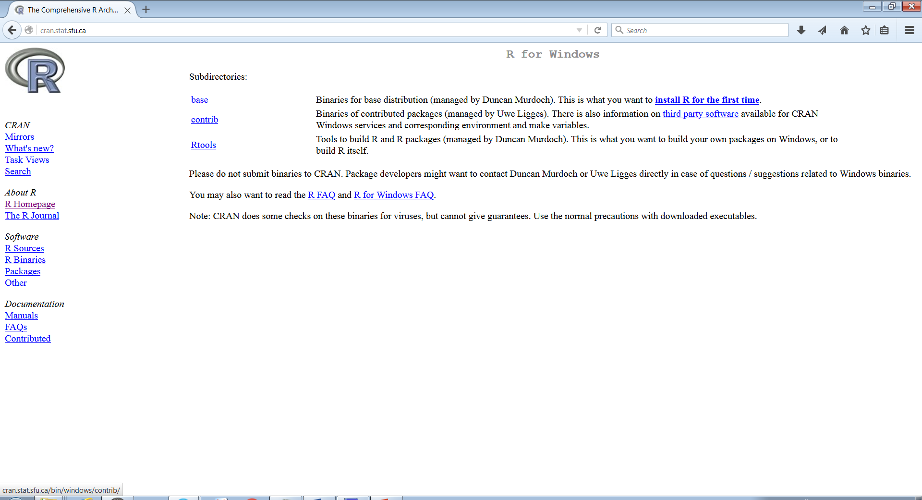
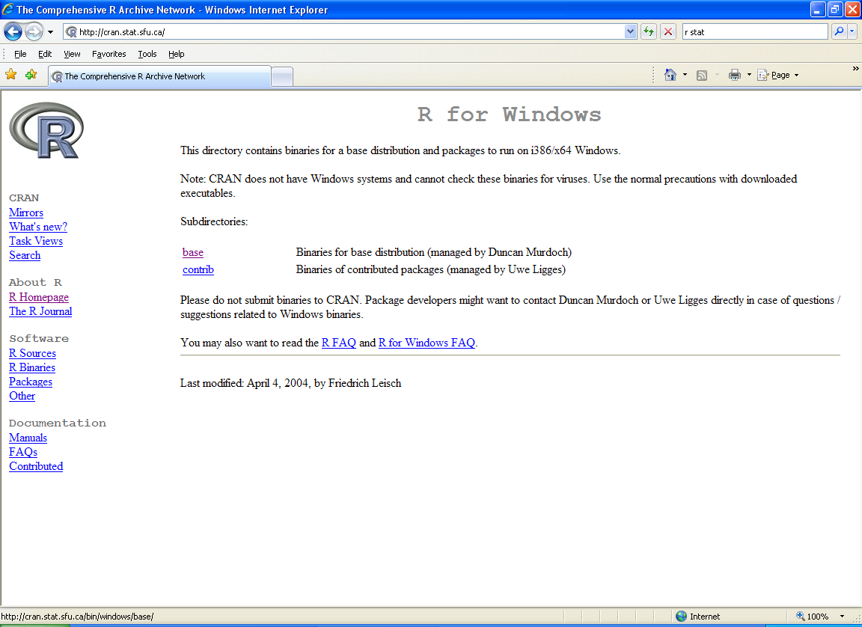

Slide 7
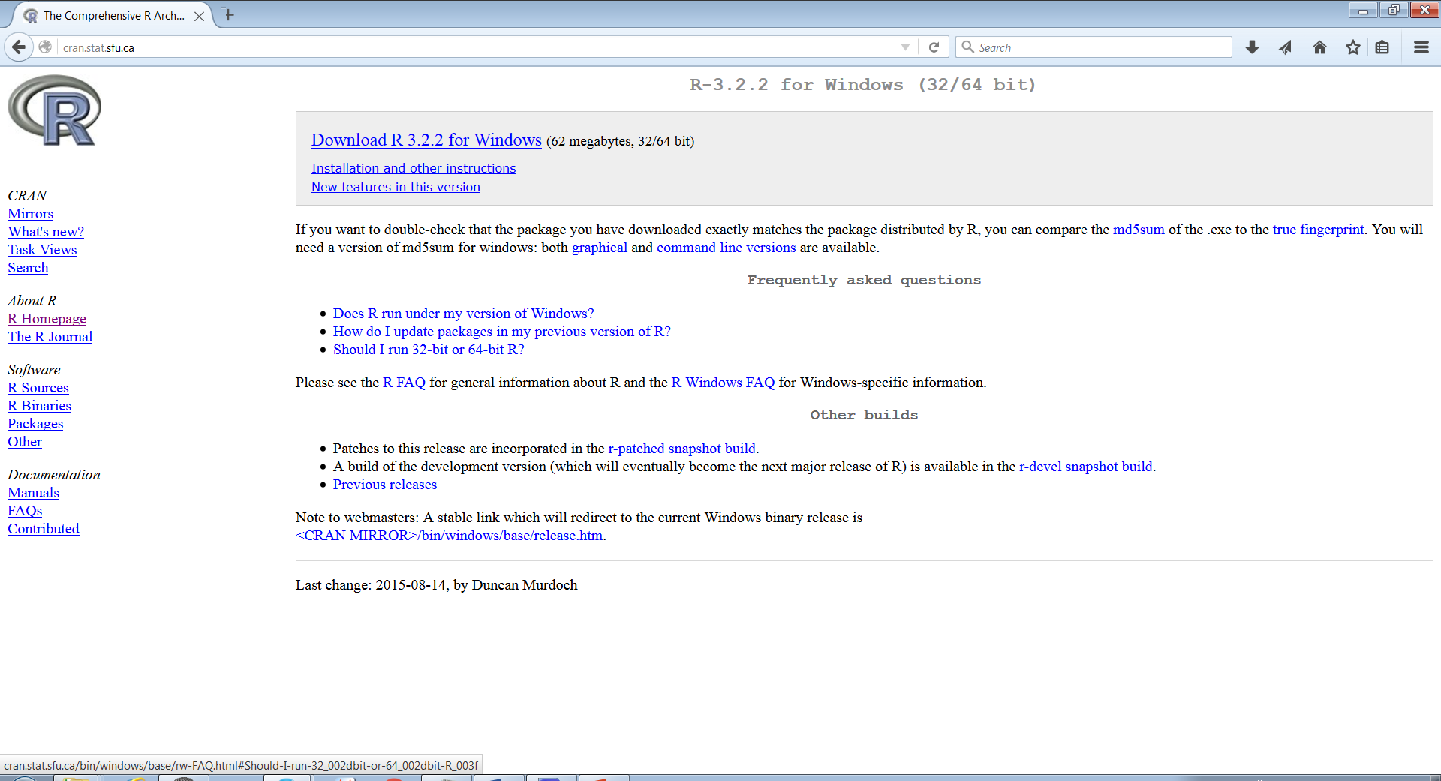
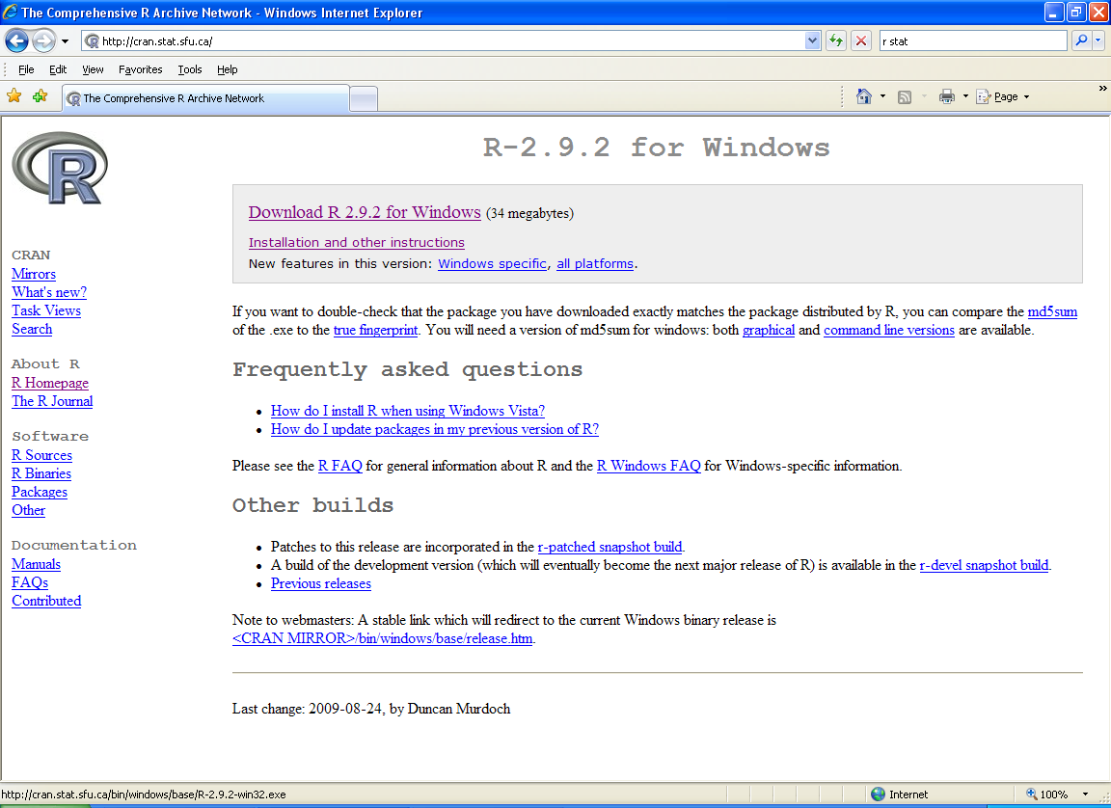

Slide 8
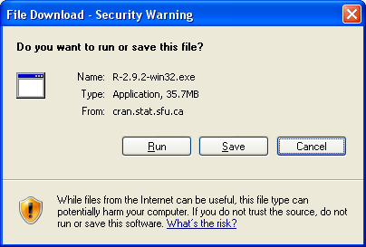
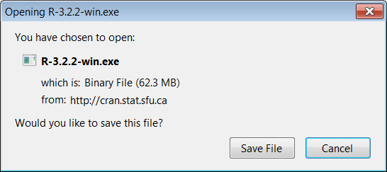

Slide 9


Slide 10
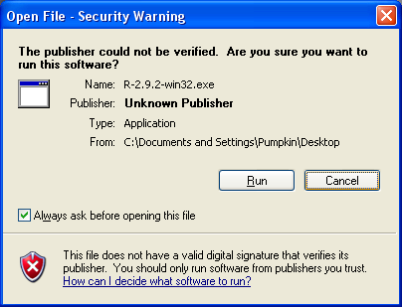
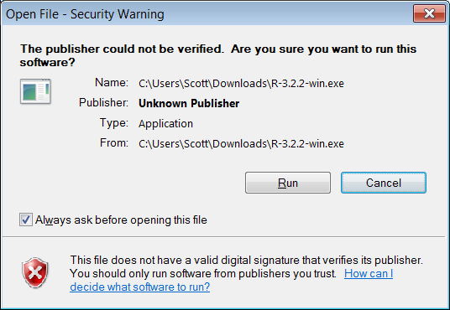

Slide 11
Choose several installation details
You can pretty safely accept all the defaults
Click on any Okay, Next or Finish buttons

Slide 12
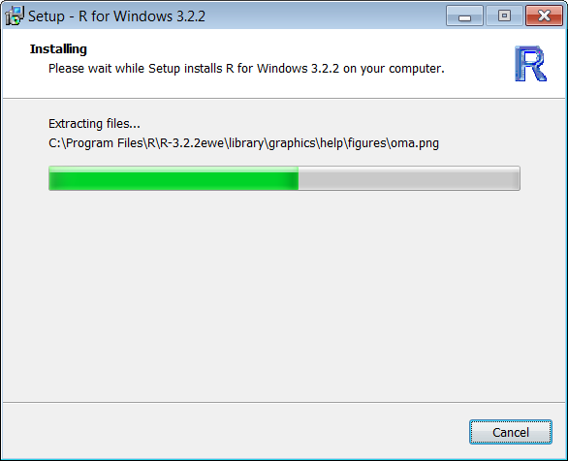
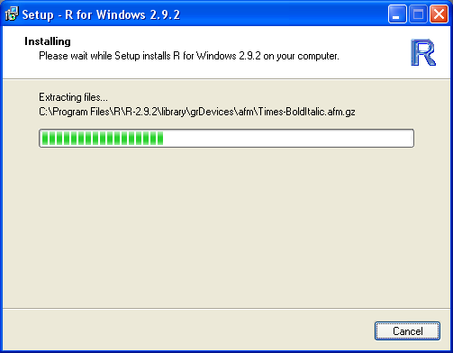

Slide 13


Slide 14
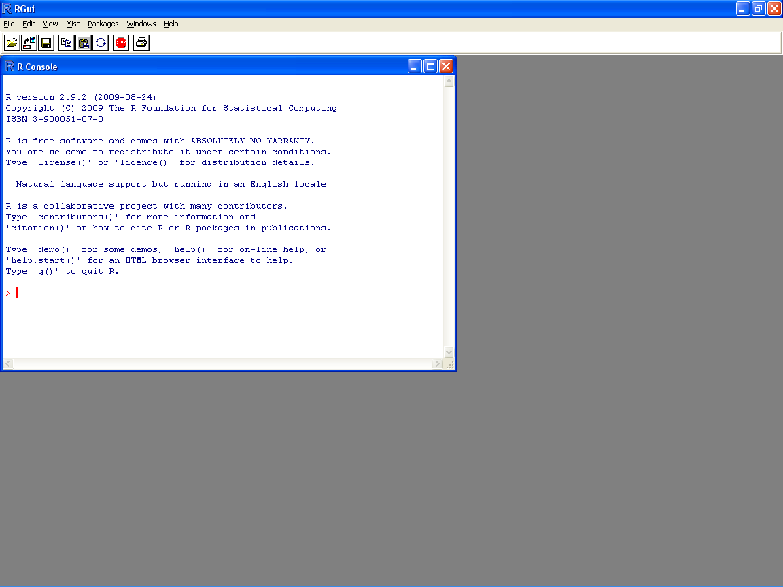
Inside R, you can enter commands and expressions
Your input is in red; its output is blue

Slide 15
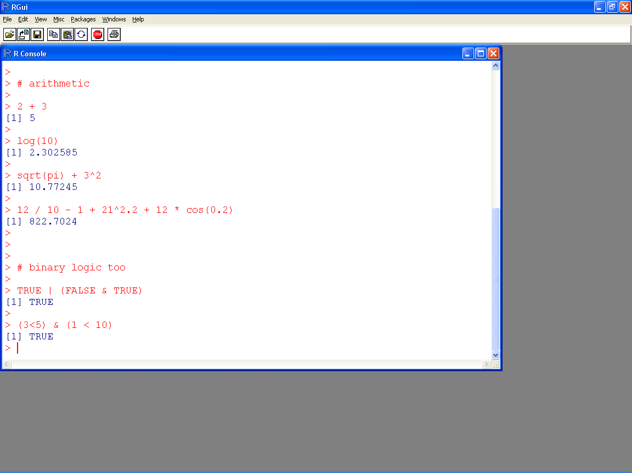
← anything after a hash tag (#) is a comment

Slide 16
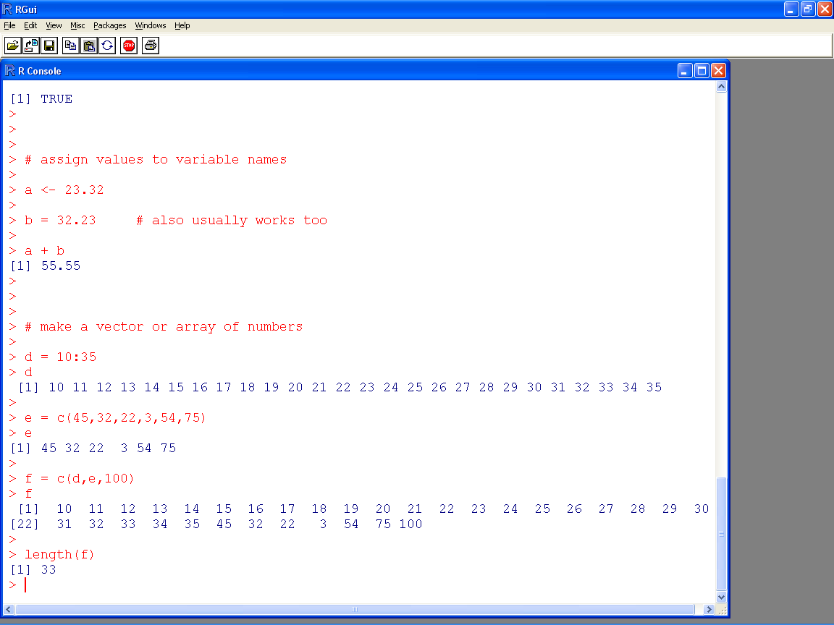

Slide 17
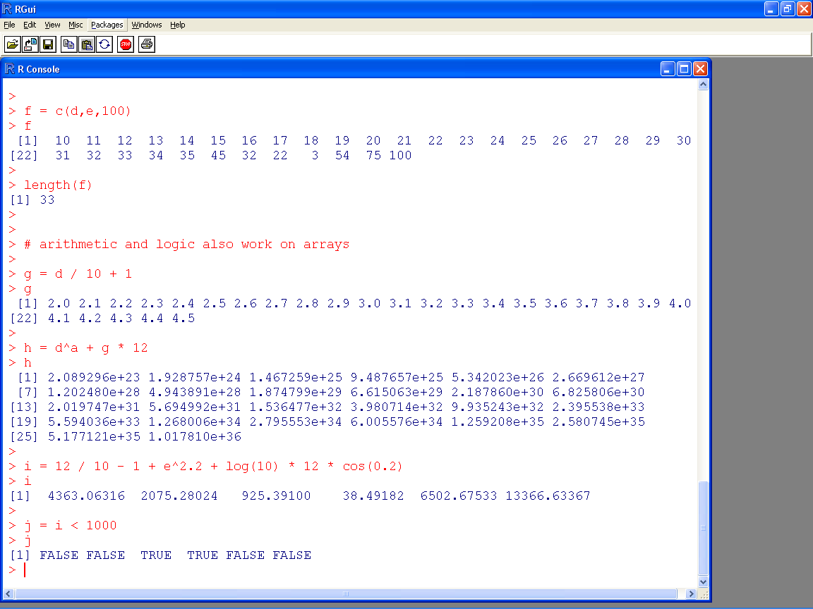

Slide 18
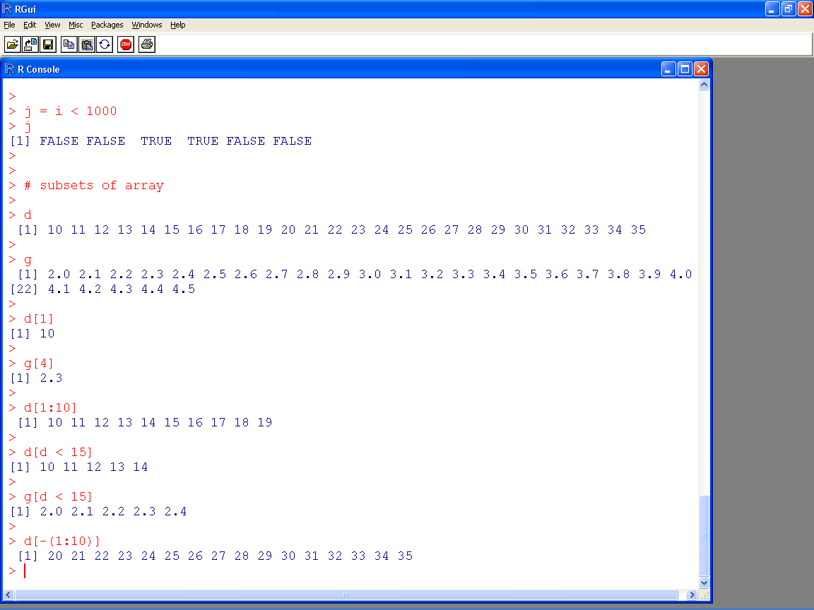

Slide 19
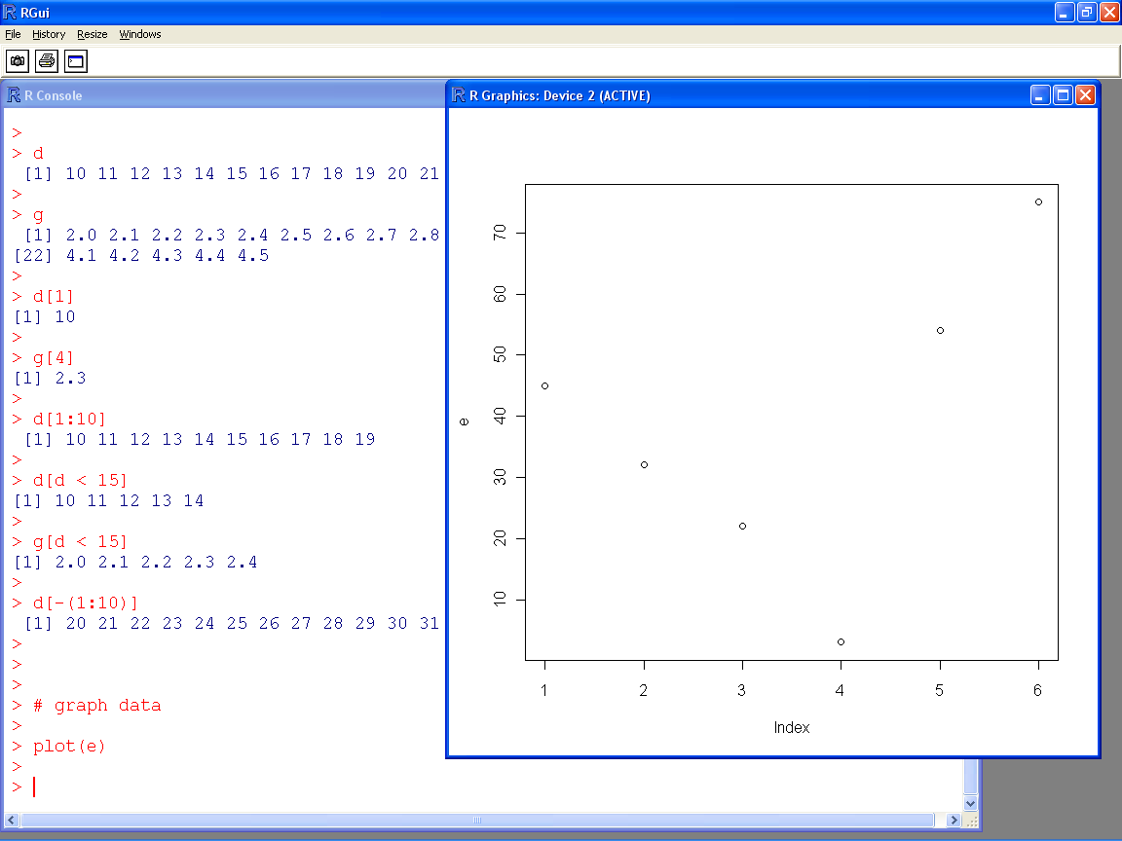

Slide 20
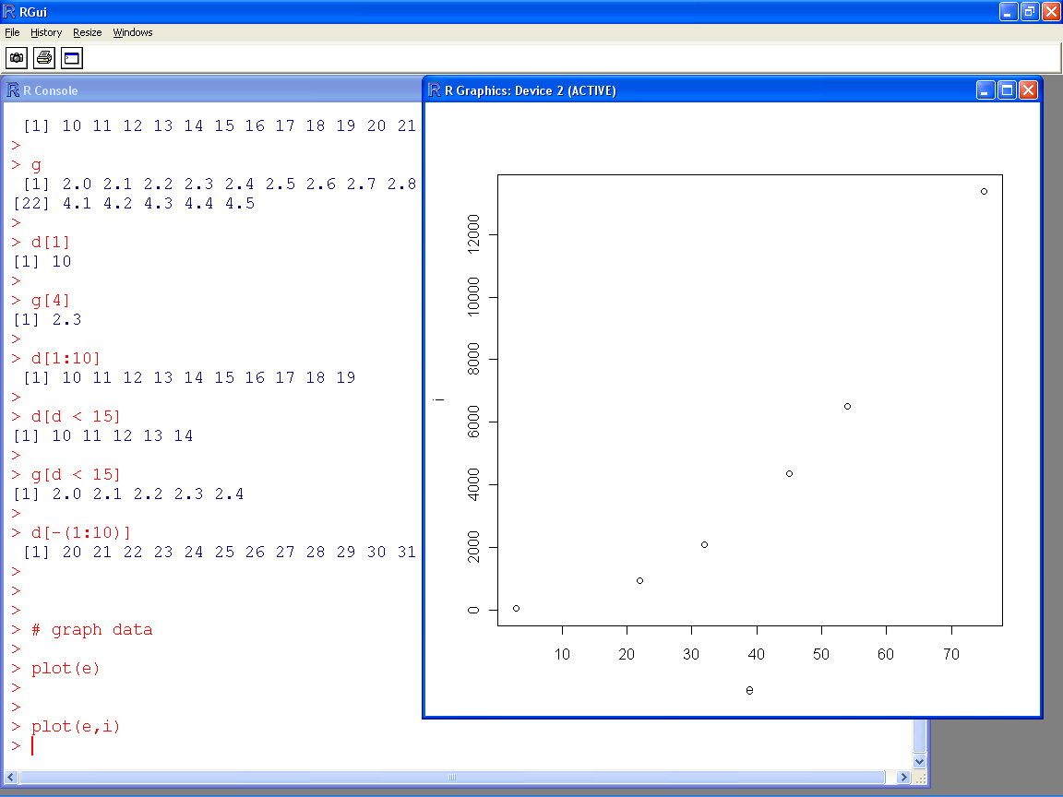

Slide 21
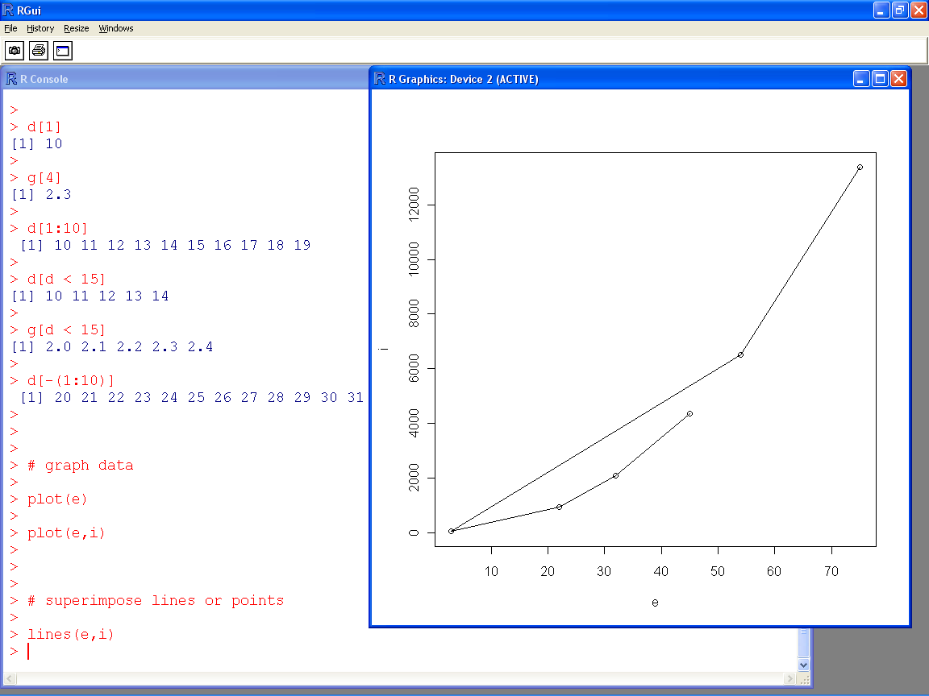

Slide 22
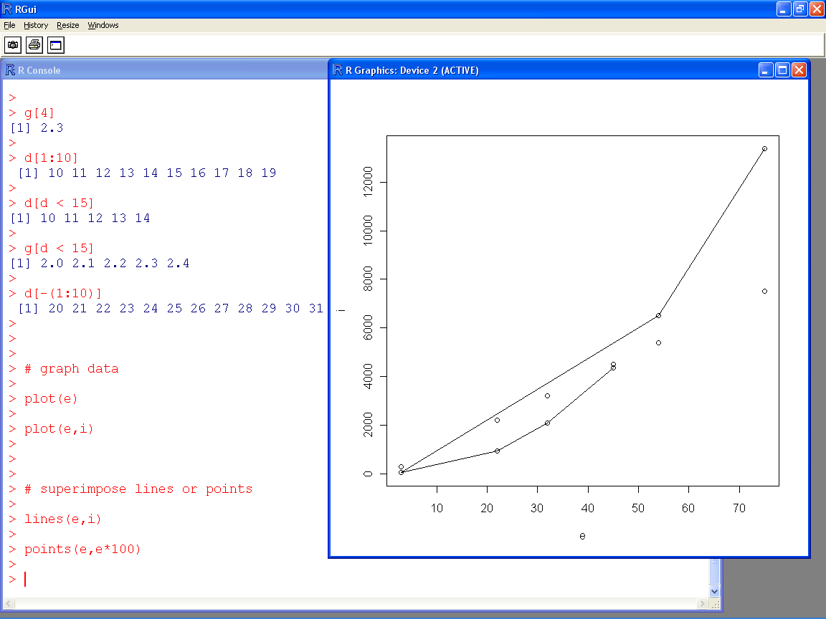

Slide 23
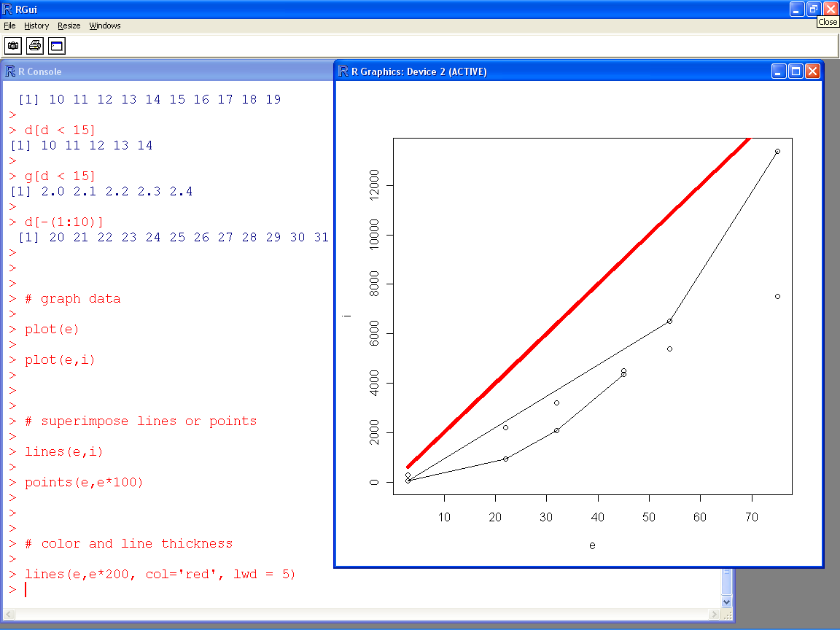

Slide 24
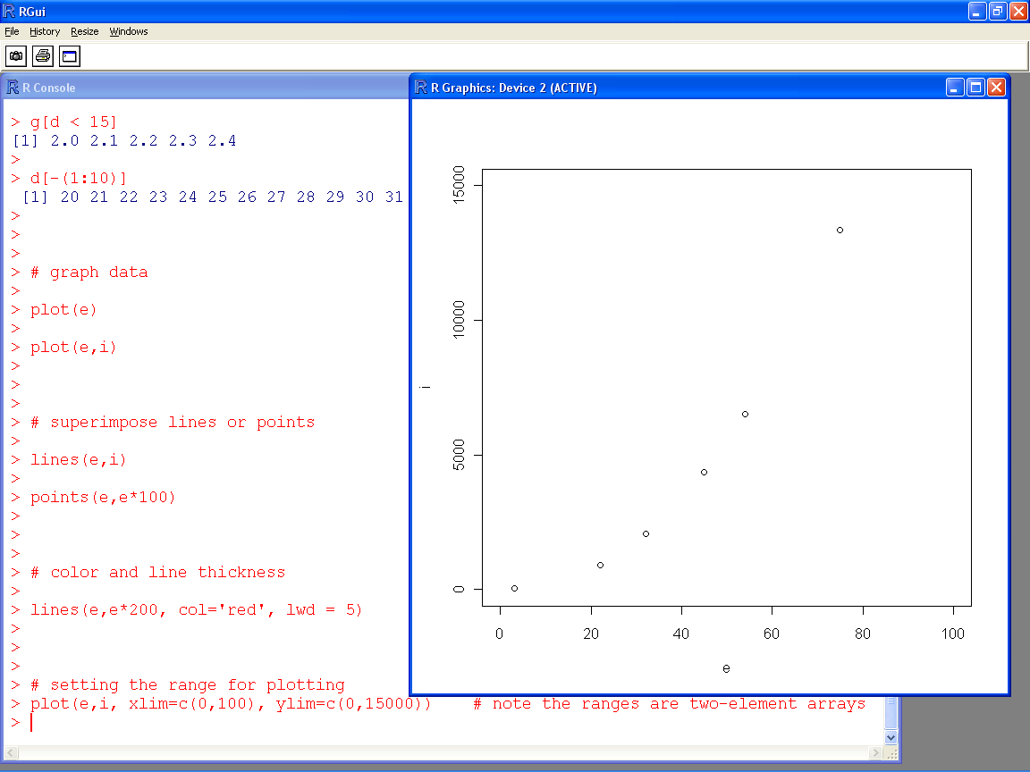

Slide 25
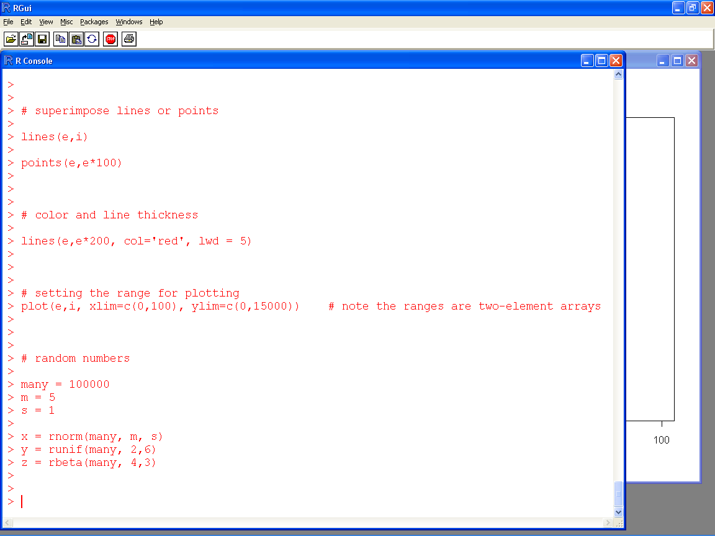

Slide 26
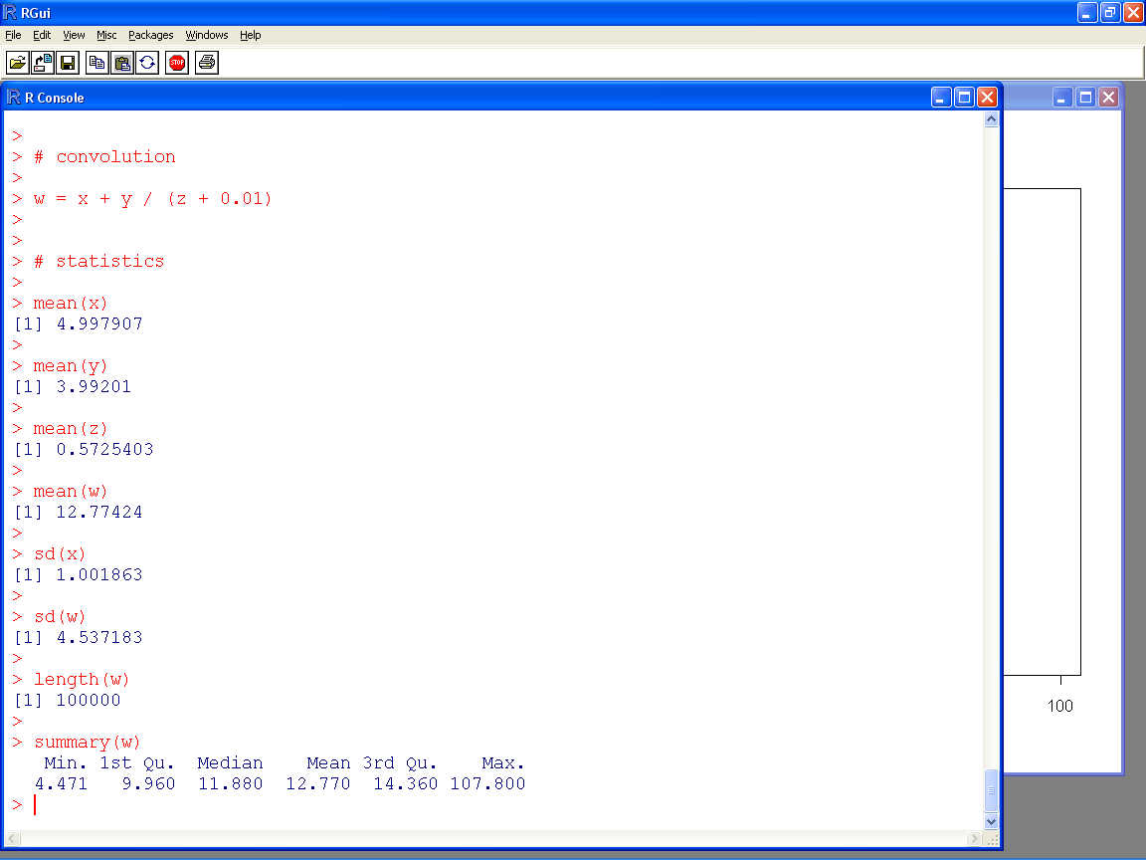

Slide 27
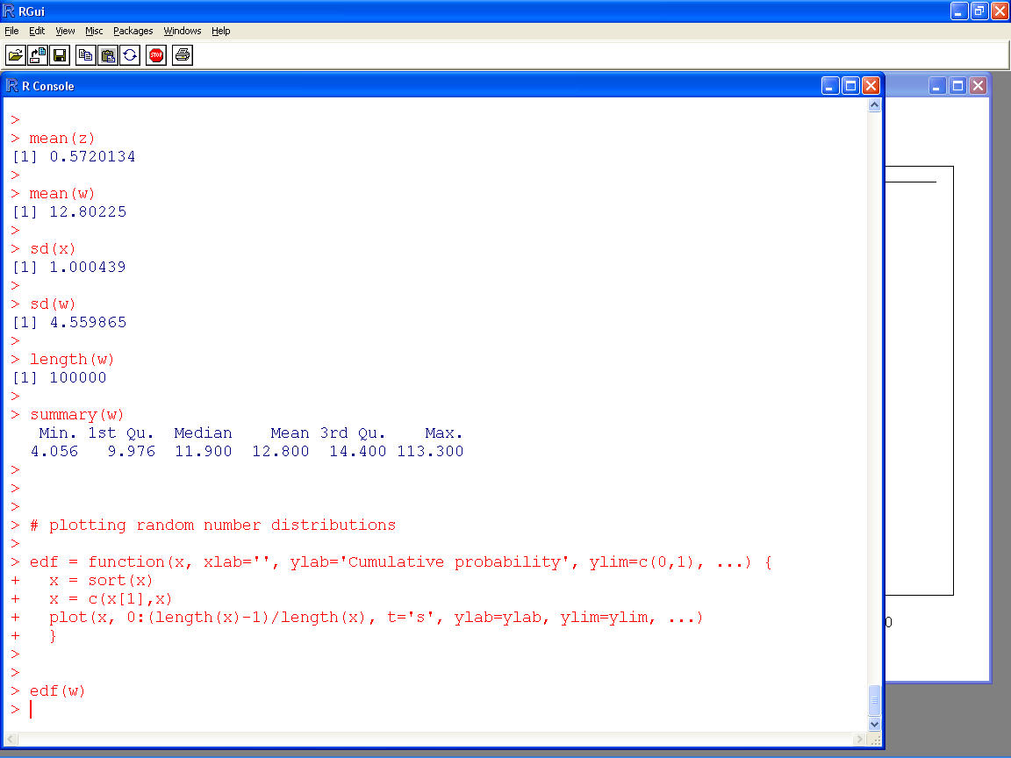

Slide 28
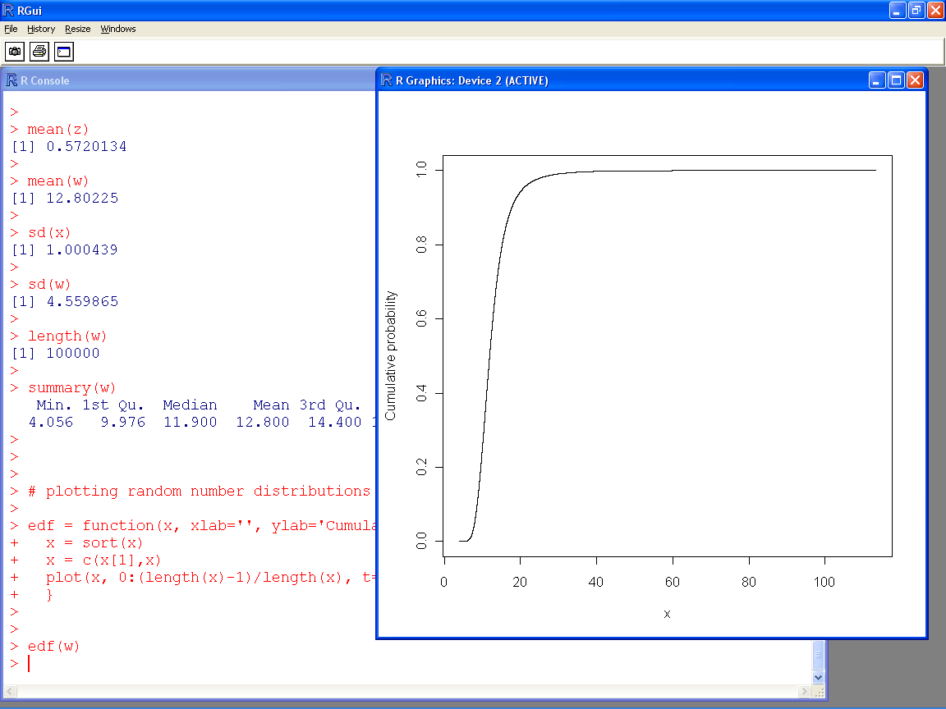

Slide 29
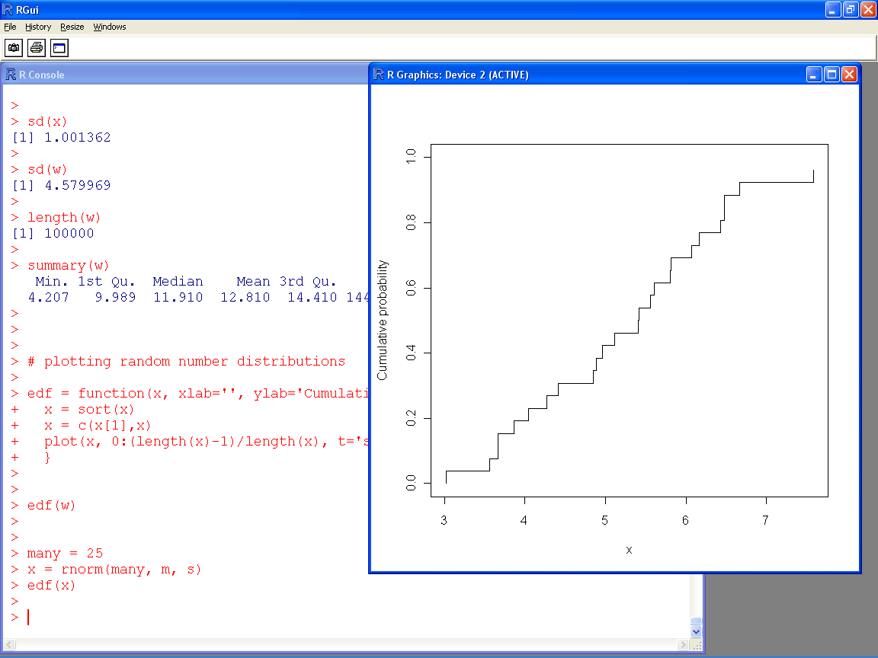

Slide 30
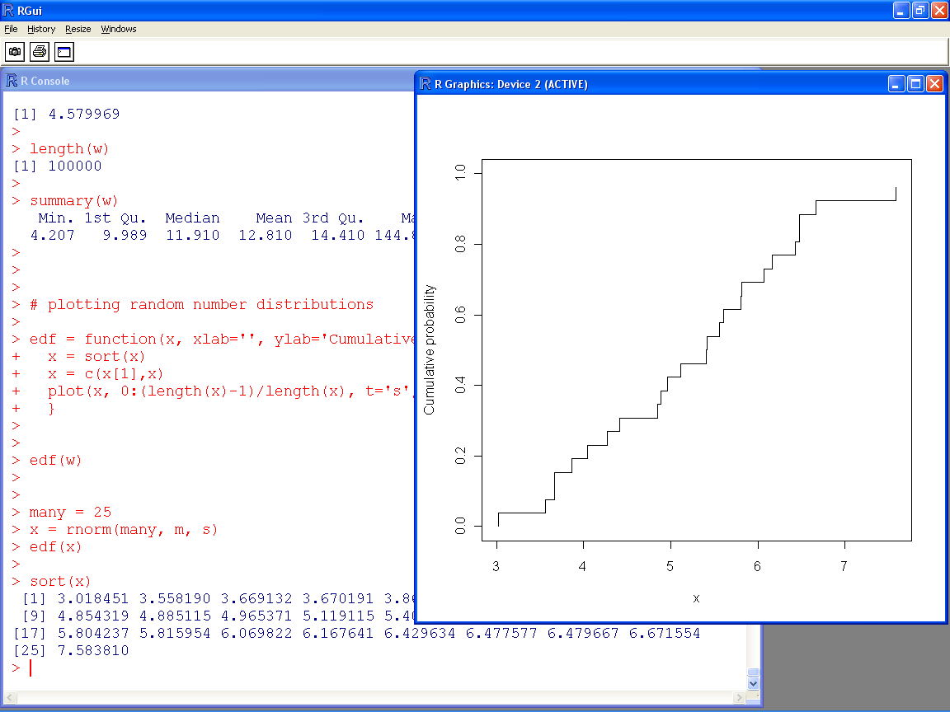

Slide 31
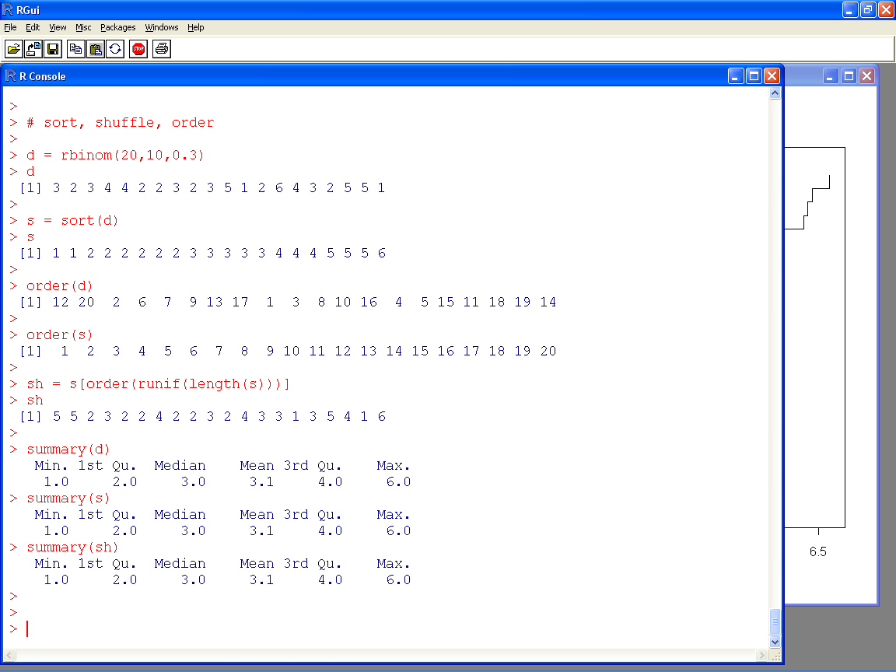

Slide 32
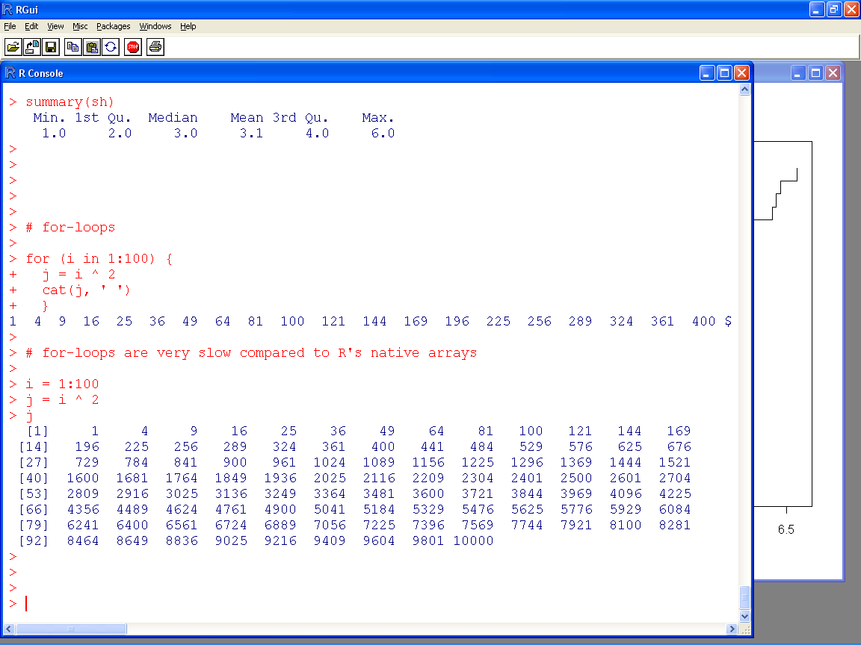

Slide 33
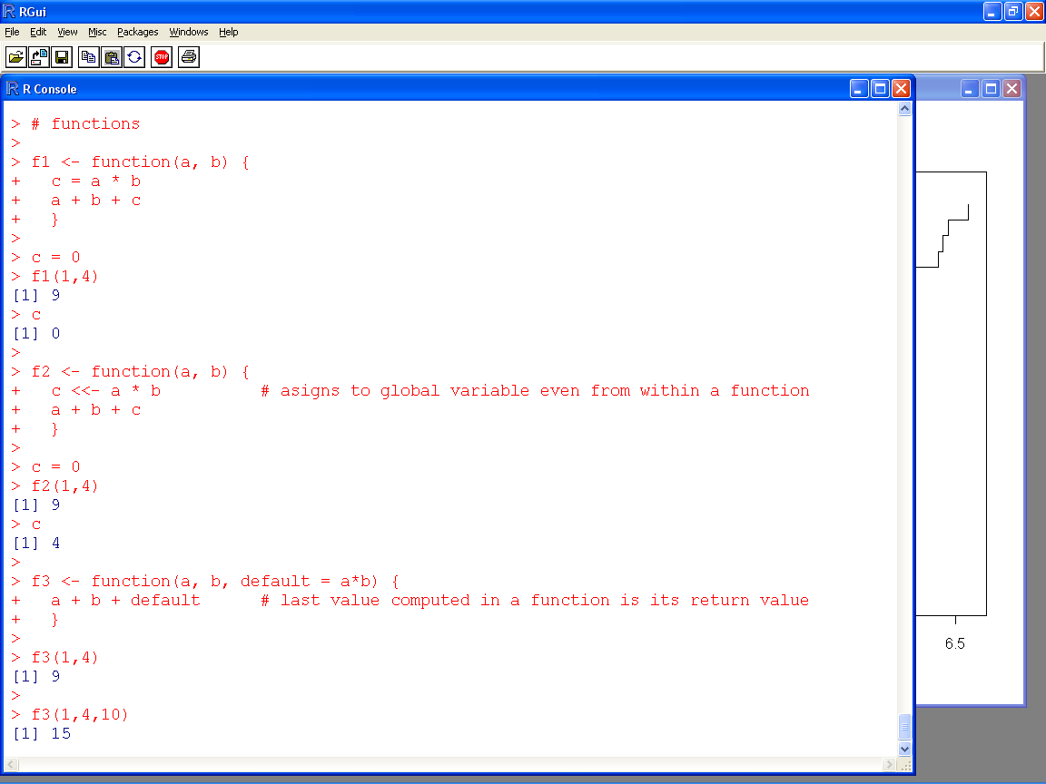

Slide 34
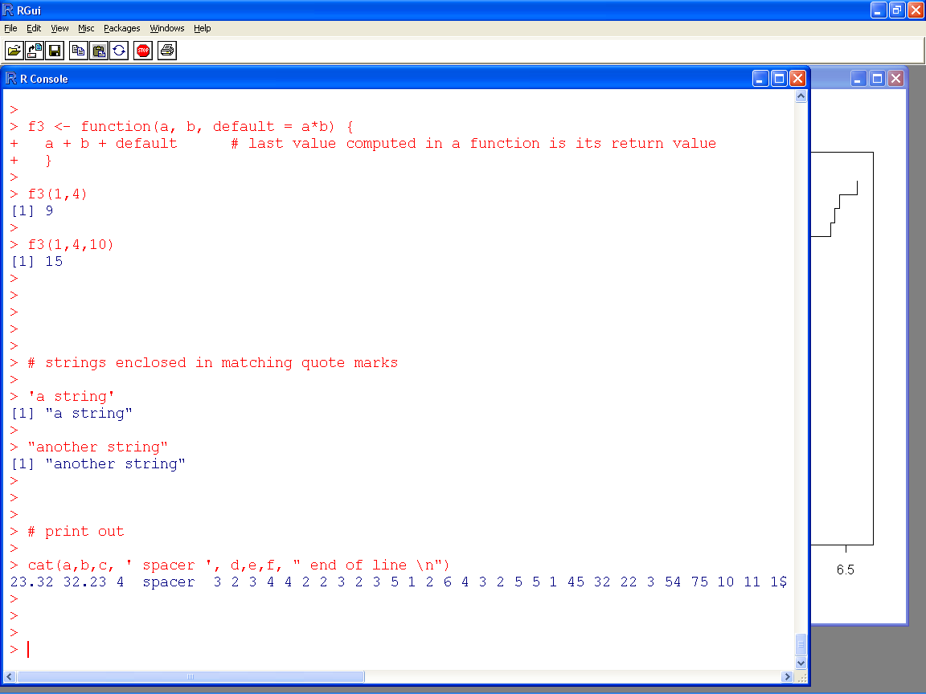

Slide 35
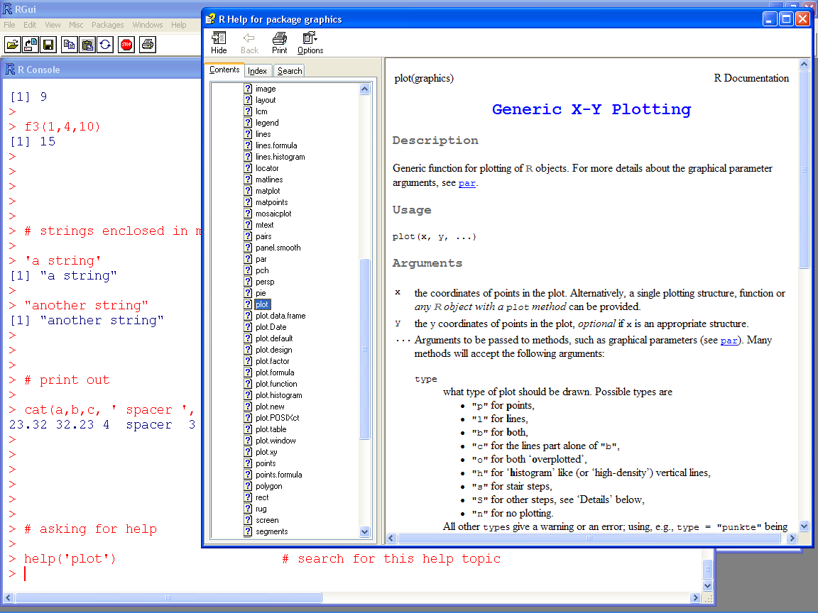

Slide 36
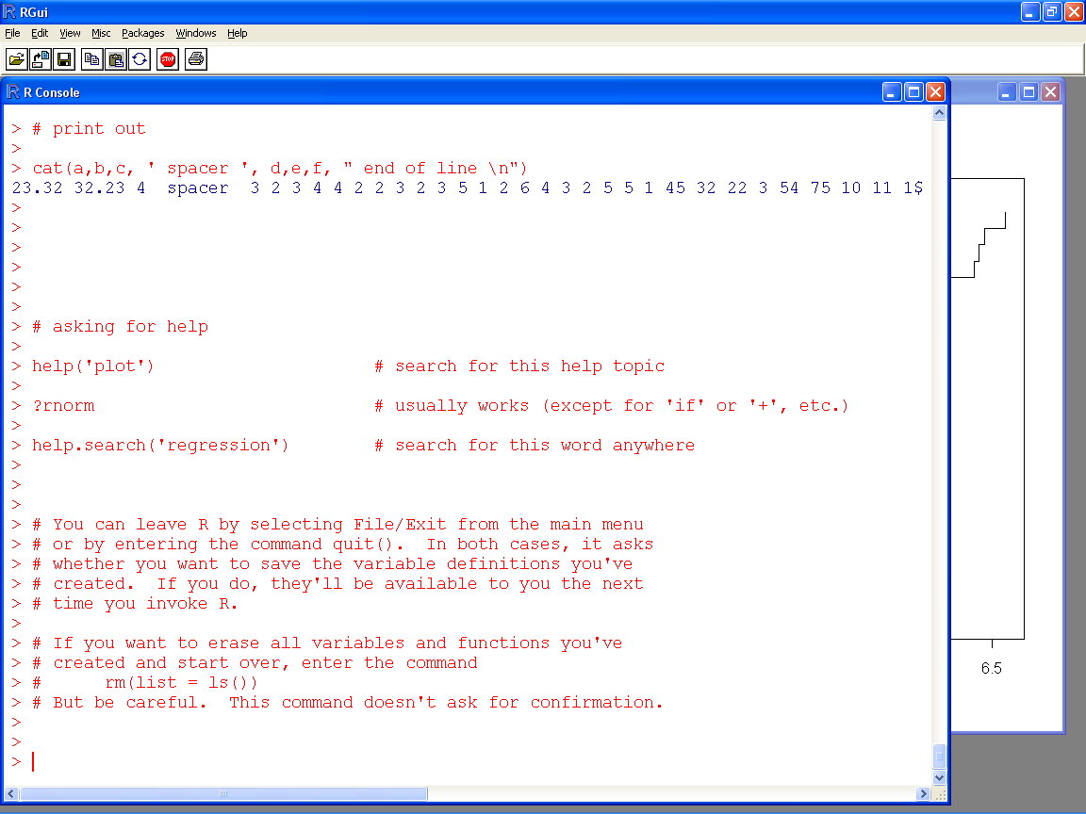

Slide 37
Installing libraries we’ll need
Click Packages / Install package(s)…, select any CRAN mirror, and click OK
After a pause, a list of packages will pop up
Select the package MASS, and click OK
You may wish to install other packages

Slide 38
Leaving R
To leave R click File / Exit from the main menu or enter the command quit()
R will ask whether you want to save your work
If you do, your variables and functions will be available the next time you invoke R
To erase all variables and functions and start fresh, enter the command rm(list = ls())

Slide 39
Installing sra.r

Slide 40
Install the sra.r Monte Carlo library
If you left R, invoke it again
Enter rm(list = ls()) to clear its memory
Click File / Source R code on the main menu
Locate and Open the file sra.r
You’ll get the message ":sra> library loaded"

Slide 41
Testing the sra.r installation
Optional
You don’t need to test the installation. Just skip to the next slide
Start a new instance of R, and enter the command rm(list = ls())
Click File / Source R code on the main menu; find and Open the file sra.r
The R Console will display something like
> source("C:\\Users\\workshop sra\\sra.r")
:sra> library loaded
Enter plot(runif(100)) which will open a plot window with random points
Click History / Recording on the main (if History is missing, click the plot)
Click on the R Console, click File / Open script, and find and Open test sra.r
Press Ctrl-A to select all its text, then press Ctrl-C to copy it to the clipboard, and close the R Editor window
Click on the R Console, and press Ctrl-V to paste the text into the R Console for execution
Click on the plot window, and press PgUp and PgDn to scroll through graphical results of the test calculations
There should be no error messages on the R Console

Slide 42
sra.r Monte Carlo library
a = normal(5,1)
a
b = uniform(2,3)
b
a + b

Slide 43
Generalized convolutions
a * b
pmin(a,b)
c = a + b * beta(2,3) / a
mean(c)

Slide 44
Functionality in sra.r
Distributions
bernoulli, beta, betapert, binomial, cauchy, chi, chisquared, delta, dirac, discreteuniform, exponential, exponentialpower, extremevalue, F, fishersnedecor, fishertippett, fisk, frechet, gamma, gaussian, geometric, gev, generalizedpareto, gumbel, histogram, inversegamma, laplace, logistic, loglogistic, lognormal, logtriangular, loguniform, MEdiscretemean, MEdiscreteminmax, MEmeansd, MEmeanvar, MEminmax, MEminmaxmean, MEminmaxmeansd, MEminmaxmeanvar, MEminmean, MEquantiles, mc (pointlist), negativebinomial, normal, N, pareto, pascal, powerfunction, poisson, quantiles, rayleigh, reciprocal, shiftedloglogistic, skewnormal, student, trapezoidal, triangular, uniform, U, weibull
Operators, functions and commands
+, *, -, /, ^, abs, acos, and, asin, atan, atan2, ceiling, complement, cor, cos, cut, edf, exp, fivenum, floor, iqr, IQR, left, lines, log, mean, median, mixture, negate, not, oppositeconv.mc, or, percentile, perfectconv.mc, plot, pmax, pmin, prob, quantile, random, reciprocate, right, round, samedistribution, sd, show, sign, sin, specific, sqrt, summary, tan, trunc, var

Slide 45
Monte Carlo in sra.r
Output
<enter variable name>, plot, lines, show, summary
Characterize
mean, sd, var, median, quantile, fivenum, left, right, prob, cut, percentile, iqr, random, range
Compute
exp, log, sqrt, abs, round, trunc, ceiling, floor, sign, sin, cos, tan, asin, acos, atan, atan2, reciprocate, negate, +, -, *, /, pmin, pmax, ^, and, or, not, mixture, smin, smax, complement

Slide 46
Monte Carlo in sra.r
Construct
normal, etc.
histogram
quantiles
MM <tab> <tab>
ME <tab> <tab>
ML <tab> <tab>
Supported named distributions
bernoulli, beta (B), binomial (Bin), cauchy, chi, chisquared, delta, dirac, discreteuniform, exponential, exponentialpower, extremevalue, F, f, fishersnedecor, fishertippett, fisk, frechet, gamma, gaussian, geometric, generalizedextremevalue (GEV), generalizedpareto, gumbel, histogram, inversegamma, laplace, logistic, loglogistic, lognormal (L), logtriangular, loguniform, negativebinomial, normal (N), pareto, pascal, powerfunction, poisson, quantiles, rayleigh, reciprocal, shiftedloglogistic, skewnormal (SN), student, trapezoidal, triangular (T), uniform (U), weibull

Slide 47
Installing pba.r

Slide 48
Install the pba.r probability box library
If you left R, invoke it again
Enter rm(list = ls()) to clear its memory
Click File / Source R code on the main menu
Locate and Open the file pba.r
You’ll get the message ":pba> library loaded"

Slide 49
Testing the pba.r installation
Optional
You don’t need to test the installation. Just skip to the next slide
Start a new instance of R, and enter the command rm(list = ls())
Click File / Source R code on the main menu; find and Open the file pba.r
The R Console will display something like
> source("C:\\Users\\workshop sra\\pba.r")
:pba> library loaded
Enter plot(runif(100)) which will open a plot window with random points
Click History / Recording on the main (if History is missing, click the plot)
Click on the R Console, click File/Open script, and find and Open test pba.r
Press Ctrl-A to select all its text, then press Ctrl-C to copy it to the clipboard, and close the R Editor window
Click on the R Console, and press Ctrl-V to paste the text into the R Console for execution
Click on the plot window, and press PgUp and PgDn to scroll through graphical results of the test calculations
There should be no error messages on the R Console

Slide 50
pba.r probability bounds library
a = normal(5,1)
a
b = uniform(2,3)
b
a + b

Slide 51
Generalized convolutions
a * b
pmin(a,b)
c = a + b * beta(2,3) / a
mean(c)

Slide 52
Probability bounds analysis in pba.r
Output
<enter variable name>, plot, lines, show, summary
Characterize
mean, sd, var, median, quantile, fivenum, left, right, prob, cut, percentile, iqr, random, range
Compute
exp, log, sqrt, abs, round, trunc, ceiling, floor, sign, sin, cos, tan, asin, acos, atan, atan2, reciprocate, negate, +, -, *, /, pmin, pmax, ^, and, or, not, mixture, smin, smax, complement

Slide 53
Probability bounds analysis in pba.r
Construct
<named distribution>
histogram
quantiles
pointlist
MM <tab> <tab>
ME <tab> <tab>
ML <tab> <tab>
CB <tab> <tab>
NV <tab> <tab>
Supported named distributions
bernoulli, beta (B), binomial (Bin), cauchy, chi, chisquared, delta, dirac, discreteuniform, exponential, exponentialpower, extremevalue, F, f, fishersnedecor, fishertippett, fisk, frechet, gamma, gaussian, geometric, generalizedextremevalue (GEV), generalizedpareto, gumbel, histogram, inversegamma, laplace, logistic, loglogistic, lognormal (L), logtriangular, loguniform, negativebinomial, normal (N), pareto, pascal, powerfunction, poisson, quantiles, rayleigh, reciprocal, shiftedloglogistic, skewnormal (SN), student, trapezoidal, triangular (T), uniform (U), weibull

Slide 54
The libraries don’t work together
After loading pba.r, the functions of sra.r will no longer work as they did before
After loading sra.r, the functions of pba.r will no longer work as they did before

Slide 55
Cheat sheet for R libraries
plot, lines, show, summary
mean, sd, var, median, quantile, left, right, prob, cut, percentile, iqr, random, range
exp, log, sqrt, abs, round, trunc, ceiling, floor, sign, sin, cos, tan, asin, acos, atan, atan2, reciprocate, negate, +, -, *, /, pmin, pmax, ^, and, or, not, mixture, smin, smax
sra.r
normal, etc.
histogram
quantiles
MM<tab><tab>
ME<tab><tab>
ML<tab><tab>
pba.r
normal, etc.
histogram
quantiles
pointlist
MM<tab><tab>
ME<tab><tab>
ML<tab><tab>
CB<tab><tab>
NV<tab><tab>
Supported named distributions
bernoulli, beta, binomial, cauchy, chi, chisquared, delta, dirac, discreteuniform, exponential, exponentialpower, extremevalue, f, fishersnedecor, fishertippett, fisk, frechet, gamma, gaussian, geometric, generalizedextremevalue, generalizedpareto, gumbel, histogram, inversegamma, laplace, logistic, loglogistic, lognormal, logtriangular, loguniform, negativebinomial, normal, pareto, pascal, powerfunction, poisson, quantiles, rayleigh, reciprocal, shiftedloglogistic, skewnormal, student, trapezoidal, triangular, uniform, Weibull
Nonparametric p-boxes
maxmean, minmax, minmaxmean, minmean, meanstd, meanvar, minmaxmode, minmaxmedian, minmaxmedianismode, minmaxpercentile, minmaxmeanismedian, minmaxmeanismode, mmms, mmmv, posmeanstd, symmeanstd, uniminmax, unimmmv, unimmms

Slide 56
Functions histogram, quantiles differ
sra.r
d = c(0,1,2,4,7,12)
k = length(d) - 1
p = 0:k/k
q = quantiles(d,p)
h =histogram(d)
p; blue(h)
d = runif(10)
ml = MLlaplace(x)
mm = MMlaplace(x)
edf(d)
red(ml)
blue(mm)
pba.r
d = c(0,1,2,4,7,12)
k = length(d) - 1
p = 0:k/k
a = quantiles(d,p)
b = pointlist(d,p)
a; red(b)
d = c(3,4,2,2,3,3,4,5,5,3,2,3)
e = histogram(d)
f = histogram(d,conf=0)
e
black(e)
green(f)

